Slide 1

Telecom Churn Case Study
Rahul Sharma

Slide 2
Univariate Analysis

Slide 3
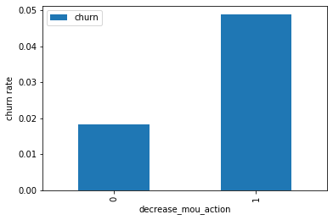
Churn rate on the basis whether the customer decreased her/his MOU in action month
We can see that the churn rate is more for the customers, whose minutes of usage(mou) decreased in the action phase than the good phase.

Slide 4
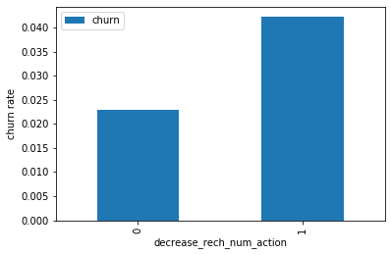
Churn rate on the basis whether the customer decreased her/his number of recharge in action month
As expected, the churn rate is more for the customers, whose number of recharge in the action phase is lesser than the number in good phase.

Slide 5
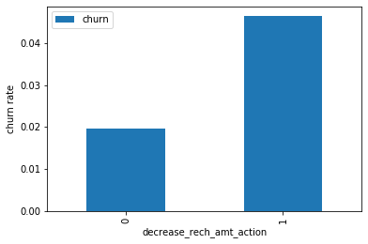
Churn rate on the basis whether the customer decreased her/his amount of recharge in action month
Here also we see the same behaviour. The churn rate is more for the customers, whose amount of recharge in the action phase is lesser than the amount in good phase.

Slide 6
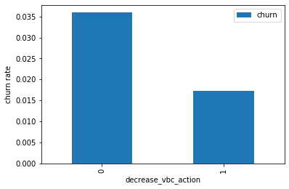
Churn rate on the basis whether the customer decreased her/his volume based cost in action month
Here we see the expected result. The churn rate is more for the customers, whose volume based cost in action month is increased. That means the customers do not do the monthly recharge more when they are in the action phase.

Slide 7
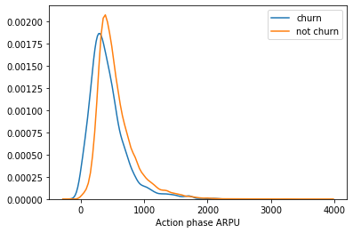
Analysis of the average revenue per customer (churn and not churn) in the action phase
Average revenue per user (ARPU) for the churned customers is mostly densed on the 0 to 900. The higher ARPU customers are less likely to be churned.
ARPU for the not churned customers is mostly densed on the 0 to 1000.

Slide 8
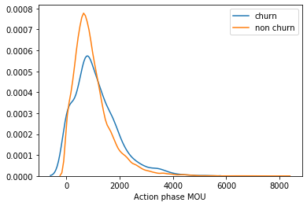
Analysis of the minutes of usage MOU (churn and not churn) in the action phase
Minutes of usage(MOU) of the churn customers is mostly populated on the 0 to 2500 range. Higher the MOU, lesser the churn probability.

Slide 9
Bivariate Analysis

Slide 10
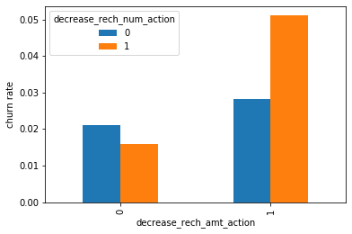
Analysis of churn rate by the decreasing recharge amount and number of recharge in the action phase
We can see from the above plot, that the churn rate is more for the customers, whose recharge amount as well as number of recharge have decreased in the action phase than the good phase.

Slide 11
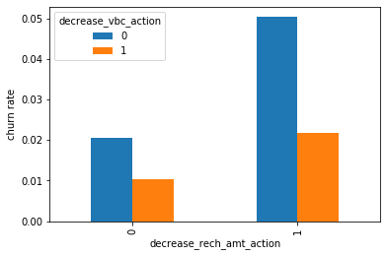
Analysis of churn rate by the decreasing recharge amount and volume based cost in the action phase
Here, also we can see that the churn rate is more for the customers, whose recharge amount is decreased along with the volume based cost is increased in the action month.

Slide 12
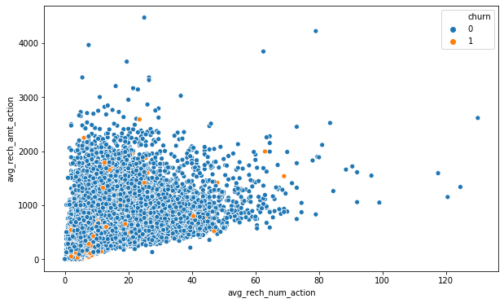
Analysis of recharge amount and number of recharge in action month
We can see from the above pattern that the recharge number and the recharge amount are mostly propotional. More the number of recharge, more the amount of the recharge.

Slide 13
Plots of important predictors for churn and non churn customers

Slide 14
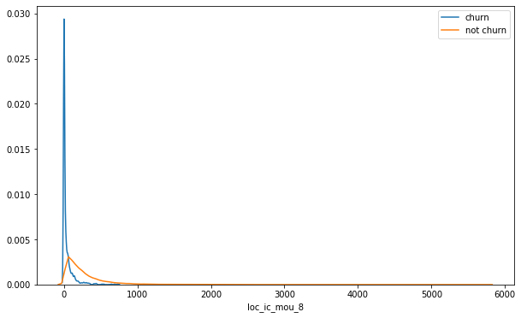
We can see that for the churn customers the minutes of usage for the month of August is mostly populated on the lower side than the non-churn customers.,

Slide 15
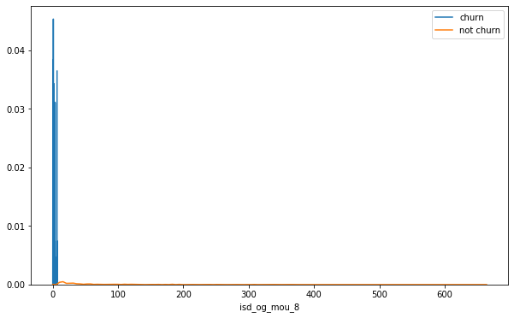
We can see that the ISD outgoing minutes of usage for the month of August for churn customers is densed approximately to zero. On the onther hand for the non churn customers it is little more than the churn customers.

Slide 16
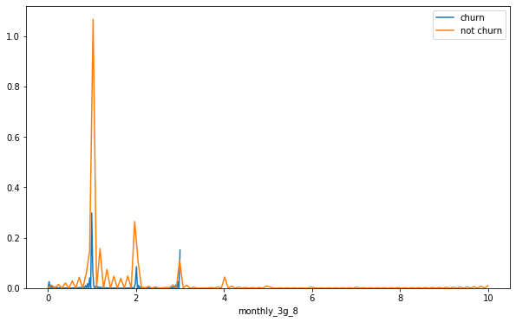
The number of mothly 3g data for August for the churn customers are very much populated aroud 1, whereas of non churn customers it spreaded accross various numbers. Similarly we can plot each variables, which have higher coefficients, churn distribution.

